Slide 1
Spin Wave Theory
Russell Ewings – ISIS Excitations Group
Some preliminaries
A physical picture of spin waves
A semi-classical approach to spin waves (ferromagnetic and antiferromagnetic chains, plus variants)
A quantum treatment of the ferromagnetic chain
The neutron inelastic cross section of spin waves
Calculating the spin wave dispersion and its neutron inelastic cross section in practice

Slide 2
Some preliminaries
Recommended reading:
“Magnetism in Condensed Matter”, by Stephen Blundell – a gentle warm up, and provides much of the inspiration for this lecture!
“Basic Aspects of the Quantum Theory of Solids”, by Daniel Khomskii – thorough discussion of the quantum treatment, but much more readable than most other textbooks. If you are studying magnetism and only buy one book during your PhD, consider making it this one…
“Introduction to the Theory of Thermal Neutron Scattering”, by Gordon Squires – the old classic, a bit dated now but has most of the equations in easily digestible form for when you need them
“Theory of Neutron Scattering from Condensed Matter”, by Stephen Lovesey – only for the hardcore, but contains everything you might ever need

Slide 3

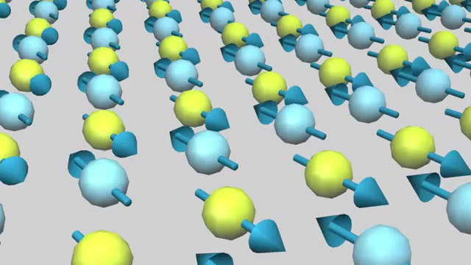
A physical picture of spin waves
MAGNONS

Slide 4
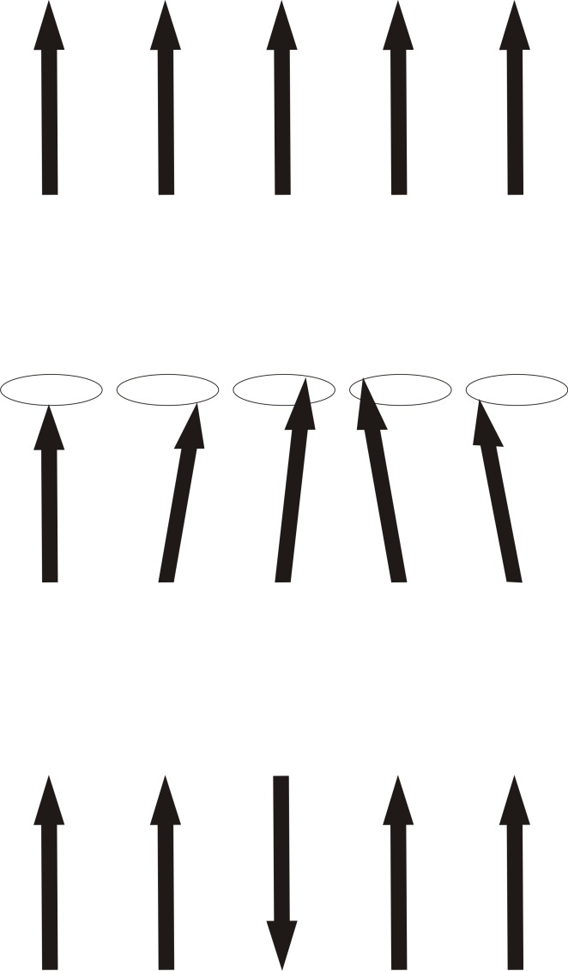
A physical picture of spin waves
Simple case – ferromagnetic chain, unperturbed
Spin wave mode – a periodic precession of the spins around their ordered direction
Contrast this with the alternative picture, of a single spin being flipped

Slide 5
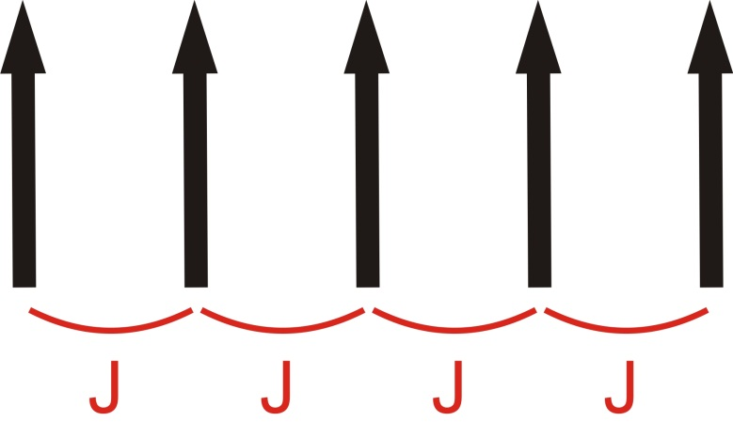
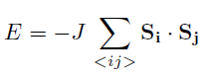
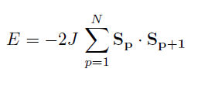
A physical picture of spin waves
We are going to consider the Heisenberg Hamiltonian, with nearest neighbour spins interacting through an exchange interaction J:
In general we would put the J term inside the sum, which would then allow us to connect more distant spins with one another (we will come back to this later on).
In what follows we will consider a spin chain, so the Hamiltonian simplifies to:
(Also note that we define the spins’ alignment direction as z)

Slide 6
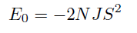
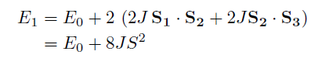
A semi-classical approach – the ferromagnetic chain
The ground state energy is
If we flip a single spin, the energy is
But it is possible to create an excitation with much less energy than this!
What we can do is let the spins “share” the spin flip, which is a key feature of a spin wave excitation

Slide 7
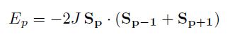
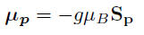
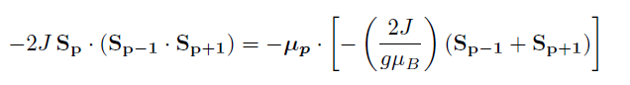
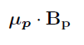
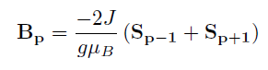
A semi-classical approach – the ferromagnetic chain
Let’s recast our problem in terms of a molecular field, acting on one spin due to the alignment of all the others.
For the p^{th} spin in the chain:
We define the p^{th} moment as:
So:
This looks like:
With:

Slide 8
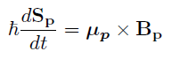
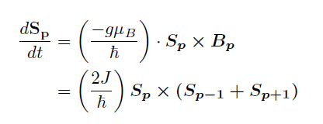
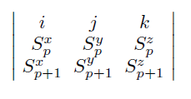
A semi-classical approach – the ferromagnetic chain
Remember from classical mechanics that the rate of change of angular momentum is equal to the torque:
So the equations of motion of the spins are:
Remember your cross products!

Slide 9
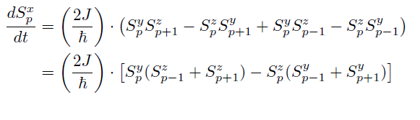
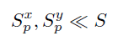
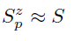
A semi-classical approach – the ferromagnetic chain
Writing out just the x-component:
To make progress we need to make some approximations (think for a moment about what these mean):

Slide 10
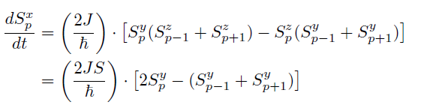
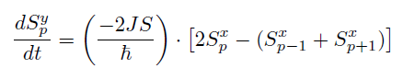
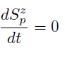
A semi-classical approach – the ferromagnetic chain
These approximations mean that we assume the fluctuations are transverse to the moment direction, and are small. It also means that products of the x and y spin components can be ignored
So our equation of motion becomes:
And similarly for the y-component:
But the z-component is different:

Slide 11
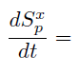
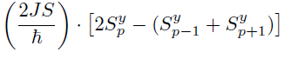
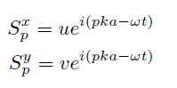
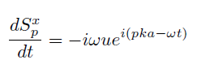
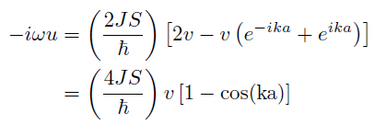
A semi-classical approach – the ferromagnetic chain
Let’s try using travelling wave solutions to these differential equations:
Where u, v are constants, and p is an integer.
This leads to:
So:

Slide 12
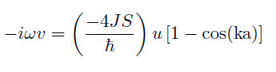
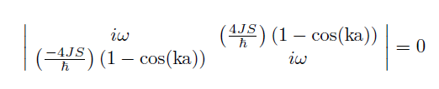
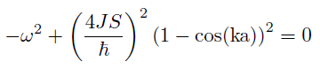
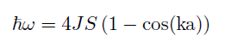
A semi-classical approach – the ferromagnetic chain
It’s a similar story for the y-component:
So in the end what we need to solve is:
Doing the maths, we get:
So our dispersion relation is:

Slide 13
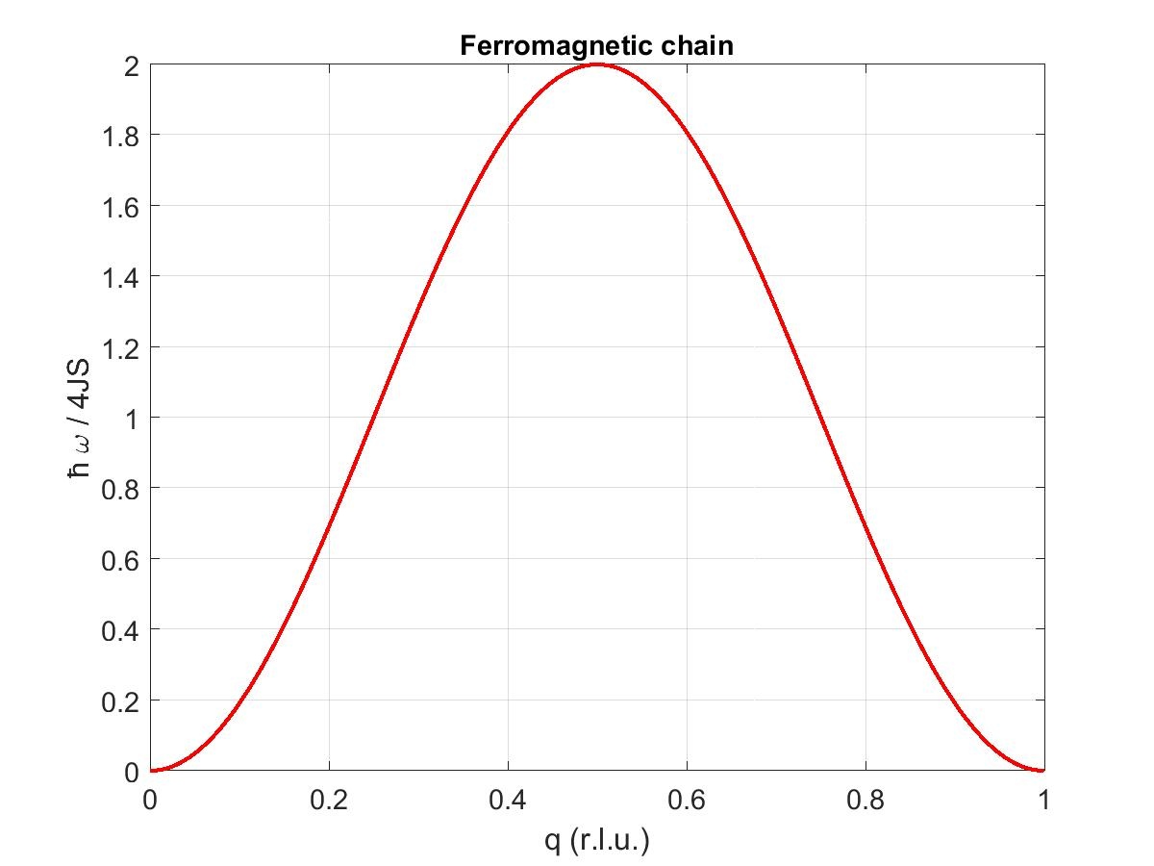
A semi-classical approach – the ferromagnetic chain

Slide 14
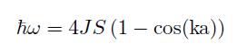
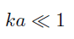
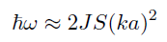
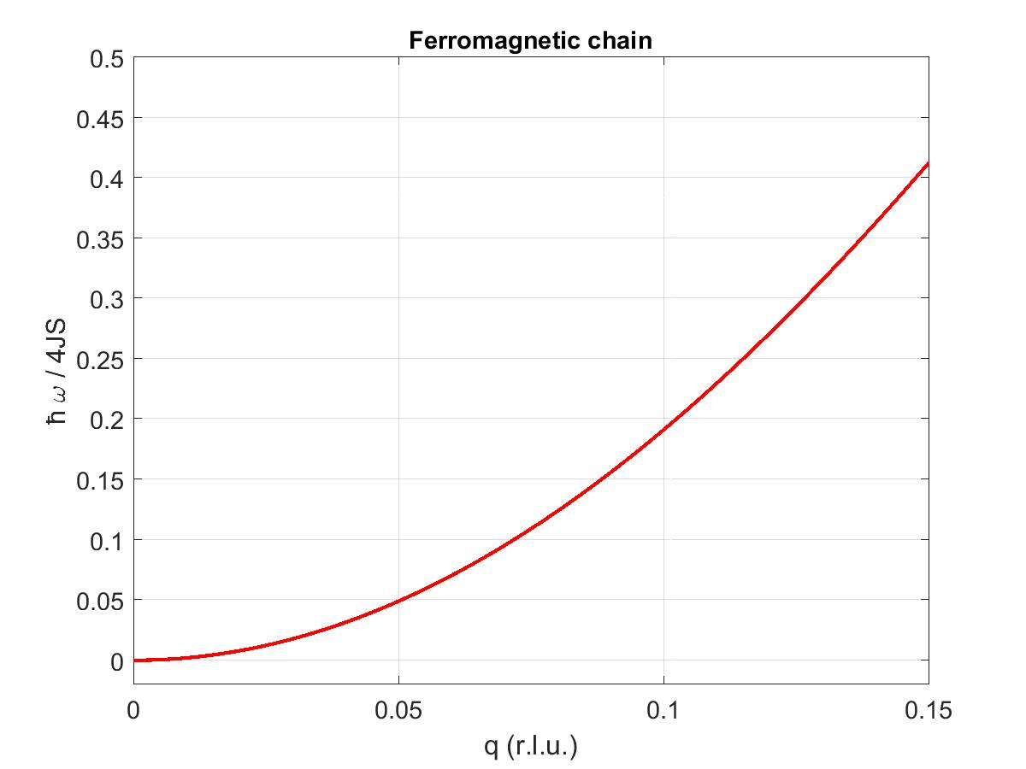
A semi-classical approach – the ferromagnetic chain
An important limit of our dispersion relation is when
, , at which point the dispersion relation is approximated by:
Rule of thumb number 1: At low Q a ferromagnet’s spin waves have a quadratic dispersion

Slide 15
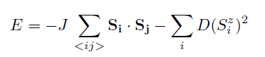
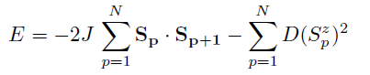
A semi-classical approach – the ferromagnetic chain
Let’s see what happens if we make the Hamiltonian a bit more complicated / realistic…
We can add a term that quantifies the single-ion anisotropy (which arises in real materials because of crystal fields due to the magnetic site geometry). This term can give an easy axis, or an easy plane, i.e. the spins lying in a particular direction or in a particular plane is energetically favourable.
Let’s consider the case where z is the easy axis. The Hamiltonian becomes:
Which for our chain we re-write as

Slide 16
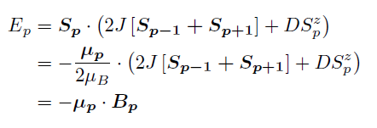
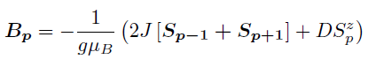
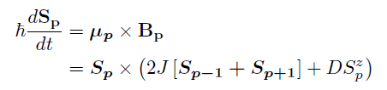
A semi-classical approach – the ferromagnetic chain
As before, consider the p^{th} spin in the chain:
Where
So:

Slide 17
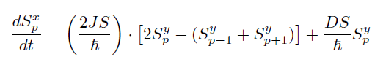
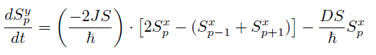
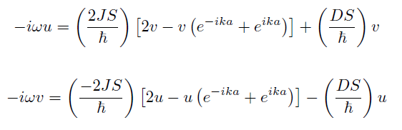
A semi-classical approach – the ferromagnetic chain
Just like before we can write this out explicitly for each component, making the same approximations as we did before about the size of the different components:
Trying the same travelling wave solutions, we get:

Slide 18
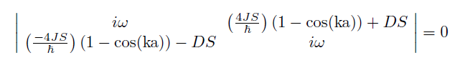
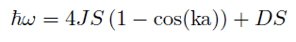
A semi-classical approach – the ferromagnetic chain
So we have something very similar to what we found previously:
So that:
An exercise to try yourself: convince yourself that this is algebraically very similar to applying a magnetic field along the z-axis.
You sometimes hear single-ion anisotropy referred to as an anisotropy field – this is why

Slide 19
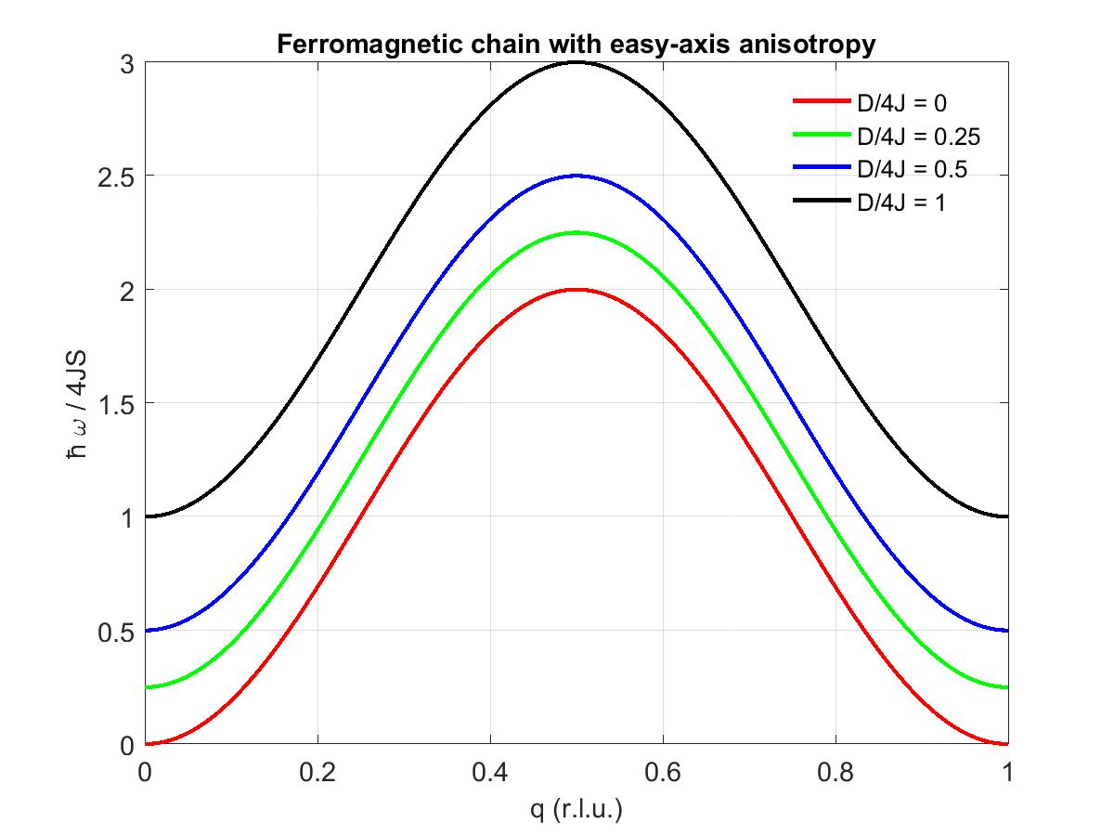
A semi-classical approach – the ferromagnetic chain

Slide 20
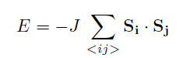
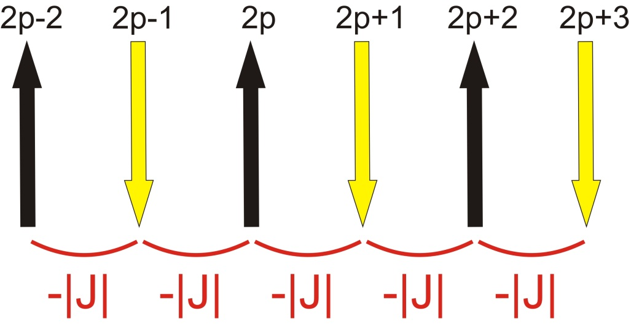
A semi-classical approach – the antiferromagnetic chain
We start with precisely the same Hamiltonian, but the crucial difference here is that the sign of J is opposite (negative, in the convention I’ve chosen)
This time we need an important insight – there are 2 sublattices (black and yellow in the picture) composed of up and down spins. In our equations of motion we need to consider the sublattices separately

Slide 21

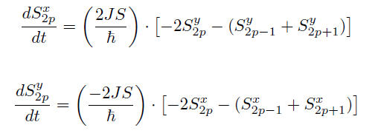
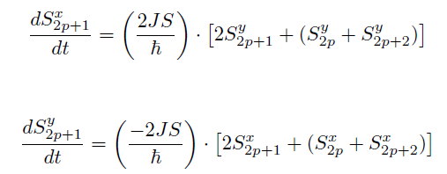
A semi-classical approach – the antiferromagnetic chain
For the up spins:
Whereas for the down spins:

Slide 22







A semi-classical approach – the antiferromagnetic chain
To make progress we need to define some new variables, namely the ladder operators (which will prove very useful when we come to the quantum treatment):
We can then re-write our equations of motion in terms of these variables:
And just like for the ferromagnet, try travelling wave solutions:

Slide 23



A semi-classical approach – the antiferromagnetic chain
With these equations of motion
We end up with another determinant to solve, which is subtly different
Which gives us our dispersion relation:

Slide 24

A semi-classical approach – the antiferromagnetic chain

Slide 25



A semi-classical approach – the antiferromagnetic chain
As we did for the ferromagnet, it is useful to consider what happens at small Q:
Rule of thumb number 2: At low Q an antiferromagnet’s spin waves have a linear dispersion

Slide 26

And Now For Something Completely Different

Slide 27




A quantum approach to the ferromagnetic chain
Let’s start by remembering the ladder operators we referred to when we were doing the classical treatment of the antiferromagnet:
and
Combining them gives:
So we can re-write the Heisenberg Hamiltonian in terms of these operators:

Slide 28


A quantum approach to the ferromagnetic chain
The ground state is when the system is fully polarised (all spins pointing up), so let’s refer to this in shorthand as: or
The actions of our operators are as follows:
In other words, the raising operator acting on a spin that is already up destroys the state, whereas the lowering operator gives a state in which the i^{th} spin is flipped and everything is multiplied by a constant.
This means the combination of raising and lowering operators in the Hamiltonian, acting on the ground state, all cancel out
This is the same ground state energy as in the
classical treatment

Slide 29


A quantum approach to the ferromagnetic chain
Let’s now define our notation for a flipped spin at the j^{th} site as
Remember that in a quantum treatment an operator that corresponds to a physical observable, applied to a state, gives you the value of that observable if it is a good quantum number, multiplied by the state itself. So thinking about the z-component of the spin:
With that in mind, let’s look at what happens if we apply the Hamiltonian to the spin-flipped state,
To figure this out, we need to think about how the individual terms act on the state

Slide 30






A quantum approach to the ferromagnetic chain
Remember the Hamiltonian is:
Looking at each of the 4 possible terms involving ladder operators:
The z-component terms are easier to deal with:

Slide 31


A quantum approach to the ferromagnetic chain
For a single value of j:
So then if we do the sum as written in the Hamiltonian, over the whole chain:
So what does this tell us?
Applying the Hamiltonian to the spin-flipped state, we do not get a number multiplied by the state itself.
So a single flipped spin is not an allowed state of the system.

Slide 32



A quantum approach to the ferromagnetic chain
So how to make progress?
Remember when we were thinking about the problem classically – rather than flipping a single spin there we said that the spin flip was shared out over all of the spins.
A quantum way of saying this is that we can think of solutions that are a superposition of states. Try the following form:
What we are hoping is that this superposition of states is allowed, i.e.
The aim of the game now is to figure out what is

Slide 33



A quantum approach to the ferromagnetic chain
Let’s write things out explicitly, to see if we can spot what is going on:
Expand out the sum near a value j:
Bringing together similar terms like this, we get

Slide 34

A quantum approach to the ferromagnetic chain
Now this is simply the ground state energy, plus a perturbation that corresponds to the spin wave excitation. The RHS is precisely the same as we got in the semi-classical treatment
We do not really have time in this lecture to consider the antiferromagnetic case, or generalising to 3D, as both are rather more complex. But see the recommended reading if you want to see how it is done…

Slide 35



The neutron inelastic cross section of spin waves
Remember that the dynamic structure factor is given by:
For an individual spin
The intensity of our neutron scattering signal is proportional to the structure factor squared:

Slide 36
The neutron inelastic cross section of spin waves
So what does this tell us?
By analogy with magnetic diffraction, where we are sensitive only to components of the magnetic moment perpendicular to the scattering wavevector Q, in inelastic scattering we are only sensitive to components of the fluctuations perpendicular to Q
Rule of thumb number 3: in inelastic scattering of spin waves we are sensitive only to the components of the fluctuation perpendicular to Q. These fluctuations are themselves perpendicular to the ordered moment direction.

Slide 37


The neutron inelastic cross section of spin waves
Example 1: Isotropic ferromagnetic chain, at two different wavevectors. Let’s say the moments lie parallel to the x-axis. In this case the fluctuations are along y and z equally.
“See” only the z-component of the fluctuation
y
x
“See” both components of the fluctuation

Slide 38


The neutron inelastic cross section of spin waves
Example 2: Anisotropic ferromagnetic chain, with easy xy-plane anisotropy, at two different wavevectors. Let’s say the moments lie parallel to the x-axis again. In this case the fluctuations are along y only.
“See” only the z-component of the fluctuation, but there isn’t one!
y
x
“See” y-component of the fluctuation (no z-component)

Slide 39




Spin waves in practice
Consider this example from the early part of the olden days:
An antiferromagnet with 4 different exchange terms, plus 2 anisotropy terms
…… Lots of tedious algebra…….

Slide 40




Spin waves in practice

Slide 41


Spin waves in practice
Why are we looking at this?
Because now the heavy algebraic lifting is taken care of by software, namely SpinW

Slide 42

Spin waves in practice
sfa = spinw;
sfa.genlattice('lat_const',[5.671 5.587 12.867],'angled',…
[90 90 90],'spgr',69)
sfa.addatom('r',[0.25 0.25 0.25],'S', 1,'label','Fe1','color','b')
plot(sfa)

Slide 43

Spin waves in practice
sfa.gencoupling('maxDistance',12.868/2)
sfa.table('bond',[1:8])

Slide 44
Spin waves in practice
sfa.addmatrix('label','J1a','value',30.8,'color','red')
sfa.addmatrix('label','J1b','value',-5,'color','green')
sfa.addmatrix('label','J2','value',21.7,'color','cyan')
sfa.addmatrix('label','Jc','value',2.3,'color','magenta')
sfa.addcoupling('mat','J1b','bond',1)
sfa.addcoupling('mat','J1a','bond',2)
sfa.addcoupling('mat','J2','bond',3)
sfa.addcoupling('mat','Jc','bond',8)
sfa.addmatrix('value',diag([-1 0 0]),'label','D','color','r')
sfa.addaniso('D')

Slide 45


Spin waves in practice
sfa.genmagstr('mode','helical','k',[1 0 1],'n',[0 1 0], 'S',…
[1; 0; 0],'nExt',[1 1 1]);
plot(sfa)

Slide 46

Spin waves in practice
Qcorner = {[1 0 -1] [1 0 1] [0 1 1] [1 0 1] [1 1 1] [0 0 1] [1 0 1] 100};
sqSpec = sfa.spinwave(Qcorner, 'hermit', false);
sqSpec = sw_neutron(sqSpec);
sqSpec = sw_egrid(sqSpec,'Evect',linspace(0,200,1000));
figure
sw_plotspec(sqSpec,'mode',3,'dashed',true,'dE',4)

Slide 47
Summary
A spin wave is a spin flip shared out over the entire system, and linear spin wave theory assumes that the fluctuations of any individual spin are small
The spin wave dispersion of a ferromagnet is quadratic at low Q
The spin wave dispersion of an antiferromagnet is linear at low Q
In an inelastic neutron scattering experiment the intensity is proportional to the component of the fluctuation perpendicular to Q (and the magnetic ordering wavevector for ferromagnets and antiferromagnets)
For analysis of all but the simplest systems, these days you should use the SpinW software. But understand what is going on behind the curtain!

